Slide 1
Medium Access Control Sublayer Chapter 4
Channel Allocation Problem
Multiple Access Protocols
Ethernet
Wireless LANs
Broadband Wireless
Bluetooth
RFID
Data Link Layer Switching

Slide 2
The MAC Sublayer
Responsible for deciding who sends next on a multi-access link
An important part of the link layer, especially for LANs
Application
Transport
Network
Link
Physical
MAC is in here!

Slide 3
Multiple Access Problem
An example: a classroom
Human protocols:
“Give everyone a chance to speak”
“Don’t speak until you are spoken to”
“Don’t monopolize the conversation”
“Raise your hand if you have a question”
“Don’t interrupt when someone is speaking”
“Don’t fall asleep when someone else is talking”
In LANs, WiFi, satellite networks, cocktail party
If more than 2 users send at the same time - collision
All collided packets are lost -> waste of bandwidth

Slide 4
Channel Allocation Problem (1)
For fixed channel and traffic from N users
Divide up bandwidth using FDM, TDM, CDMA, etc.
This is a static allocation, e.g., FM radio
This static allocation performs poorly for bursty traffic
Allocation to a user will sometimes go unused
Dynamic allocation gives the channel to a user when they need it.
Potentially N times as efficient for N users.

Slide 5
Channel Allocation Problem (2)
Schemes vary with assumptions:
Assumption | Implication
Independent traffic | Often not a good model, but permits analysis
Single channel | No external way to coordinate senders
Observable collisions | Needed for reliability; mechanisms vary
Continuous or slotted time | Slotting may improve performance
Carrier sense | Can improve performance if available
Notes:
In random-access or contention no station is superior to another station and
none is assigned control over another.
At each instance, a station that has data to send uses a procedure defined by the protocol to make a decision on whether or not to send. This decision depends on the state of the medium (idle or busy).

Slide 6
Medium Access Control Sublayer Chapter 4
Channel Allocation Problem
Multiple Access Protocols
Ethernet
Wireless LANs
Broadband Wireless
Bluetooth
RFID
Data Link Layer Switching

Slide 7
Multiple Access Protocols
ALOHA »
CSMA (Carrier Sense Multiple Access) »
Collision-free protocols »
Limited-contention protocols »
Wireless LAN protocols »

Slide 8
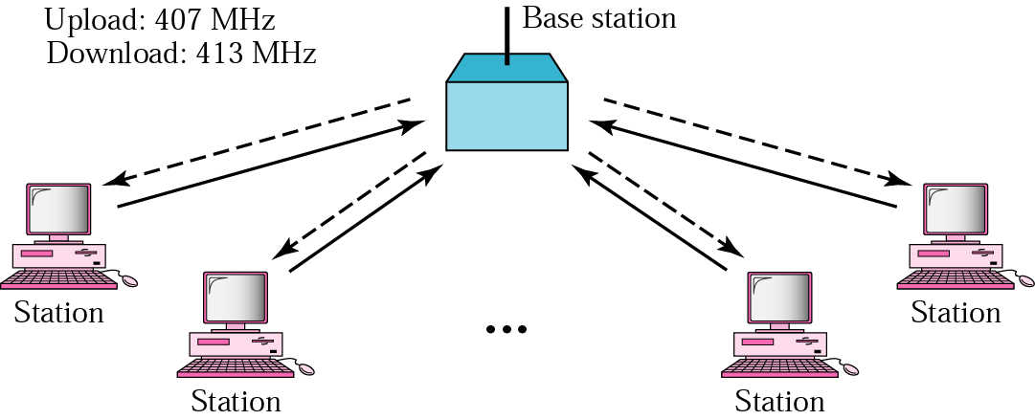
ALOHA Network
Developed by Norm Abramson at the Univ. of Hawaii
the guy had interest in surfing and packet switching
mountainous islands → land-based network difficult to install
fully decentralized protocol
ACK
ACK
ACK
ACK
Notes:
ALOHA(Additive Link On-Line Hawaii system)

Slide 9
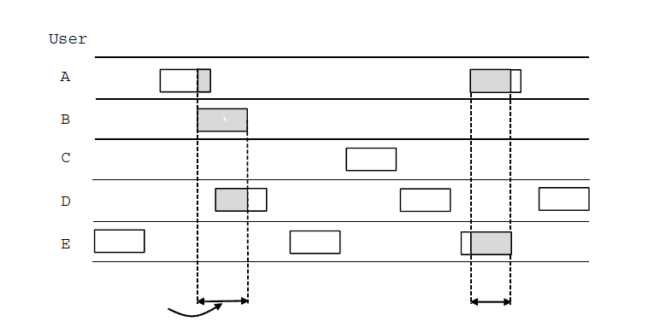
Pure ALOHA
In pure ALOHA, users transmit frames whenever they have data; users retry after a random time for collisions
Efficient and low-delay under low load
`
User
A
B
C
D
E
Collision
Collision
Time
Notes:
ALOHA, the earliest random access method, was developed at the University of Hawaii in early 1970.
It was designed for a radio (wireless) LAN, but it can be used on any shared medium.
It is obvious that there are potential collisions in this arrangement. The medium is shared between the stations. When a station sends data, another station may attempt to do so at the same time. The data from the two stations collide and become garbled.

Slide 10
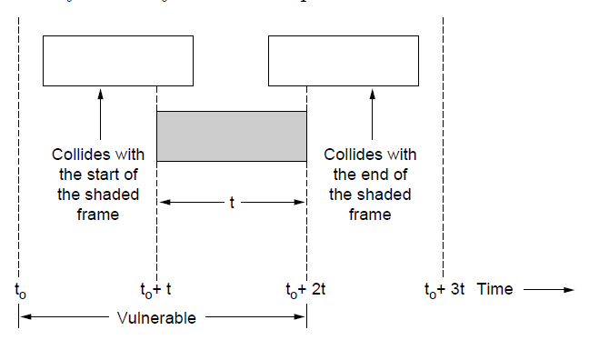
Vulnerable Period
Collisions happen when other users transmit during a vulnerable period that is twice the frame time
Synchronizing senders to slots can reduce collisions
Frame time: the frame length divided by the bit rate

Slide 11
Example
A pure ALOHA network transmits 200-bit frames on a shared channel of 200 kbps.
What is the requirement to make this frame collision-free?
Solution
Frame time is 200 bits/200 kbps or 1 ms.
The vulnerable time is 2 × 1 ms = 2 ms.
This means no station should send later than 1 ms before this station starts transmission and no station should start sending during the period (1ms) that this station is sending.

Slide 12
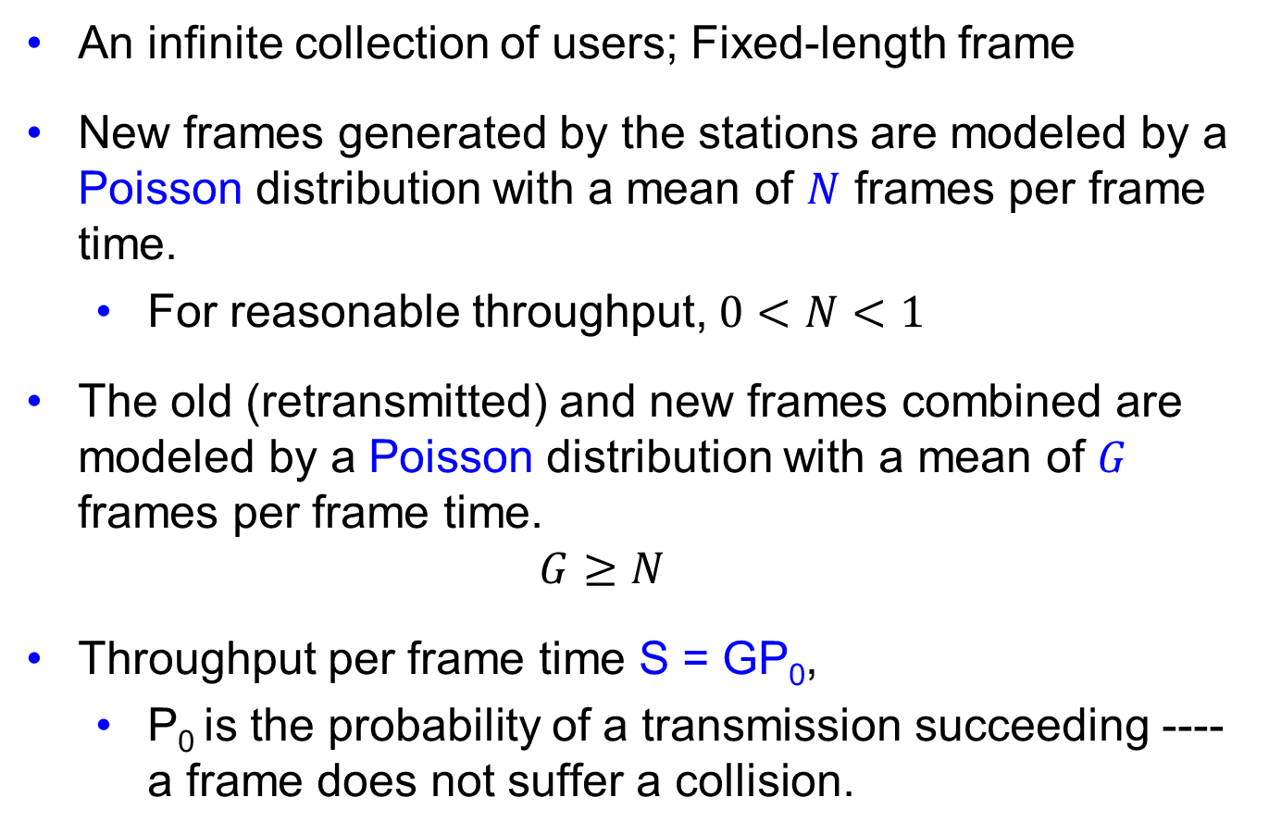
Channel Utilization (1)
An infinite collection of users; Fixed-length frame
New frames generated by the stations are modeled by a Poisson distribution with a mean of $N$ frames per frame time.
For reasonable throughput, $0<N<1$
The old (retransmitted) and new frames combined are modeled by a Poisson distribution with a mean of $G$ frames per frame time.
$$G≥N$$
Throughput per frame time S = GP₀,
P₀ is the probability of a transmission succeeding ---- a frame does not suffer a collision.

Slide 13
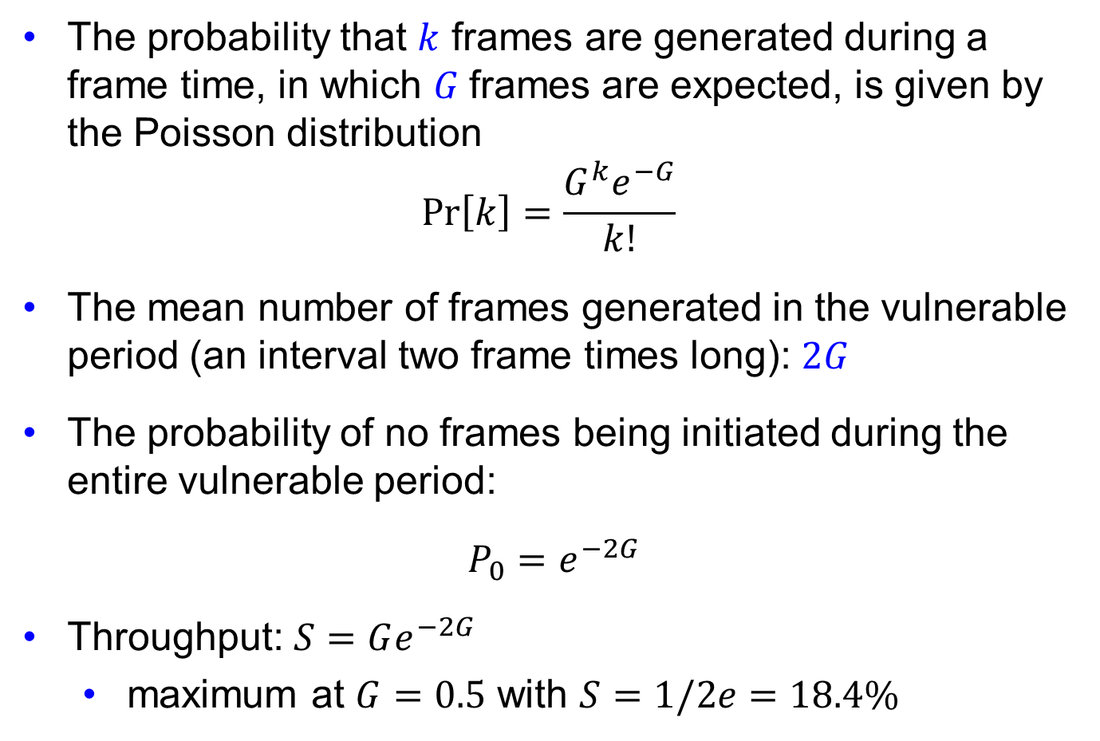
Channel Utilization (2)
The probability that $k$ frames are generated during a frame time, in which $G$frames are expected, is given by the Poisson distribution
$$\operatorname{Pr}\left[k\right]=\frac{G^{k}e^{−G}}{k!}$$
The mean number of frames generated in the vulnerable period (an interval two frame times long): $2G$
The probability of no frames being initiated during the entire vulnerable period:
$P_{0}=e^{−2G}$
Throughput: $S=Ge^{−2G}$
maximum at $G=0.5$ with $S=1/2e=18.4\%$

Slide 14
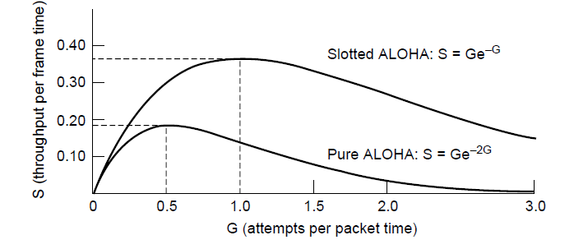
Slotted ALOHA
Slotted ALOHA is twice as efficient as pure ALOHA
Low load wastes slots, high loads causes collisions
Efficiency up to 1/e (37%) for random traffic models
Applied in Internet access over cable, multiple RFID tags talk to the same RFID reader

Slide 15
Example
A pure ALOHA network transmits 200-bit frames on a shared channel of 200 kbps.
What is the throughput if the system (all stations together) produces
a. 1000 frames per second?
b. 500 frames per second?
c. 250 frames per second?

Slide 16
Solution
The frame time is 200 bits/200 kbps or 1 ms.
a. If the system creates 1000 frames per second, or 1 frame per millisecond, then G = 1. In this case S = G × e^{−2G} = 0.135 (13.5%). This means that the throughput is 1000 × 0.135 = 135 frames. Only 135 frames out of 1000 will probably survive.
b. If the system creates 500 frames per second, or 1/2 frames per millisecond, then G = 1/2. In this case S = G × e^{−2G} = 0.184 (18.4%). This means that the throughput is 500 × 0.184 = 92. Only 92 frames out of 500 will probably survive.
c. If the system creates 250 frames per second, or 1/4 frames per millisecond, then G = 1/4. In this case S = G× e^{−2G} = 0.152 (15.2%). This means that the throughput is 250 × 0.152 = 38. Only 38 frames out of 250 will probably survive

Slide 17
Multiple Access Protocols
ALOHA »
CSMA (Carrier Sense Multiple Access) »
Collision-free protocols »
Limited-contention protocols »
Wireless LAN protocols »

Slide 18
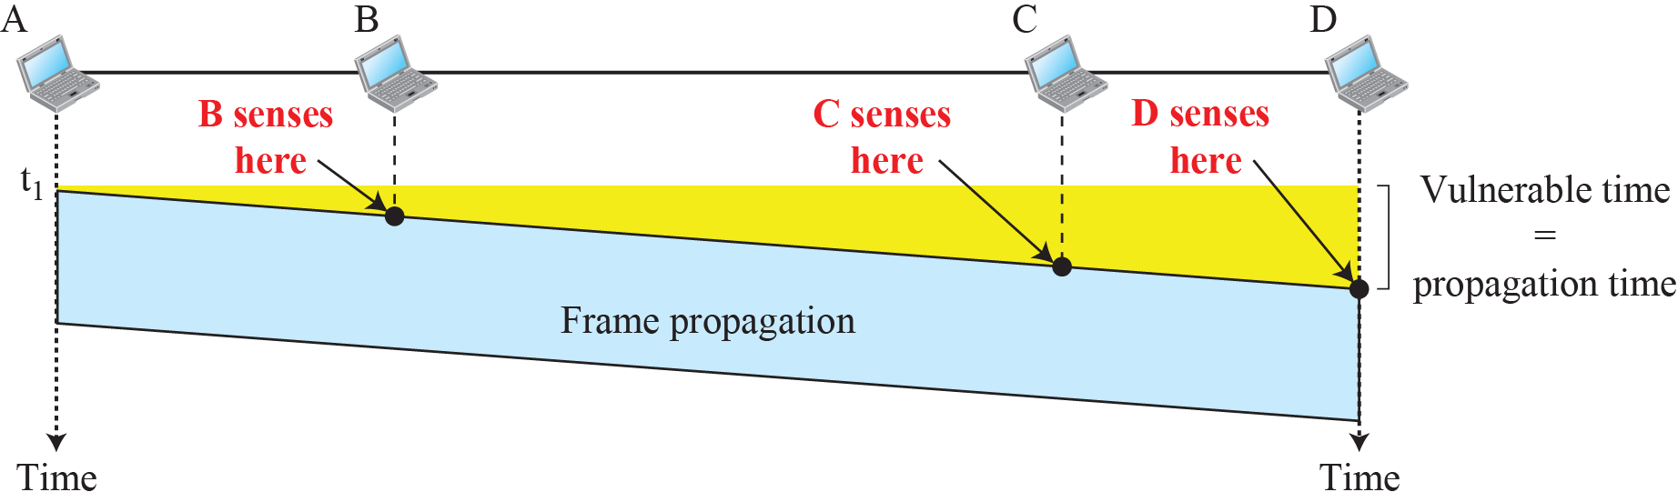
CSMA (1)
CSMA improves on ALOHA by sensing the channel!
User doesn’t send if it senses someone else
Based on the principle “sense before transmit” or “listen before talk.”
Notes:
802.11 uses a refinement of p-persistent CSMA

Slide 19
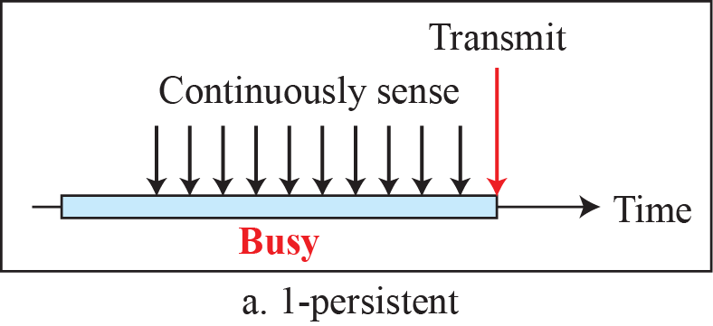
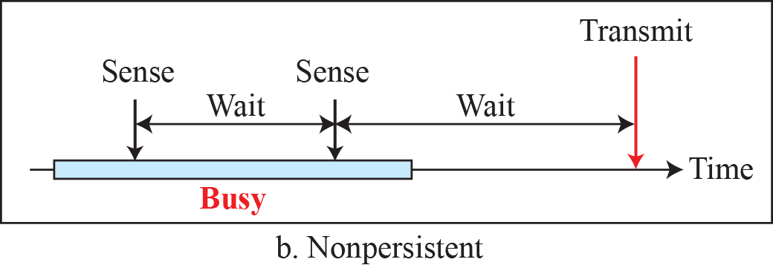
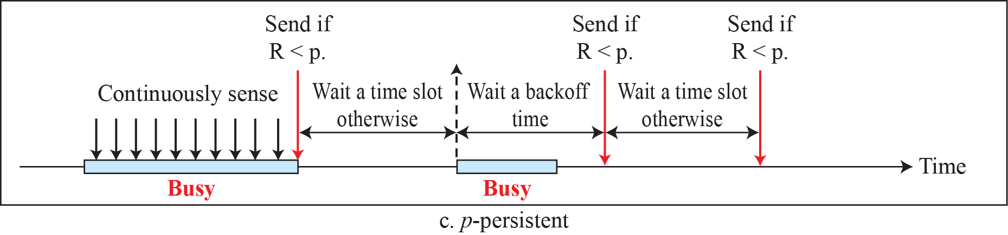
Behavior of three persistence methods
Variations on what to do if the channel is busy:
1-persistent (greedy) sends as soon as idle
Nonpersistent waits a random time then tries again
p-persistent sends with probability p when idle

Slide 20
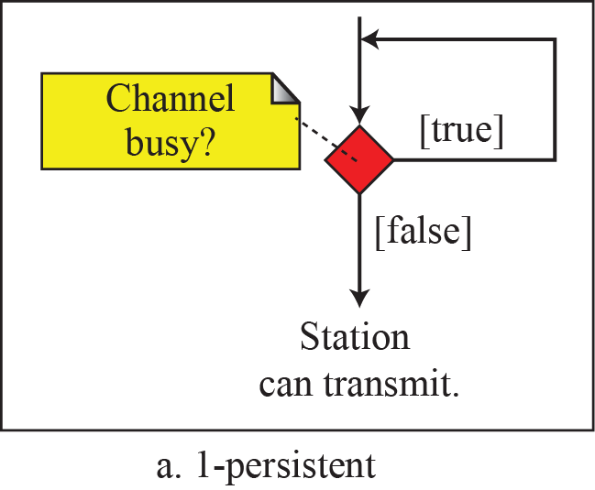
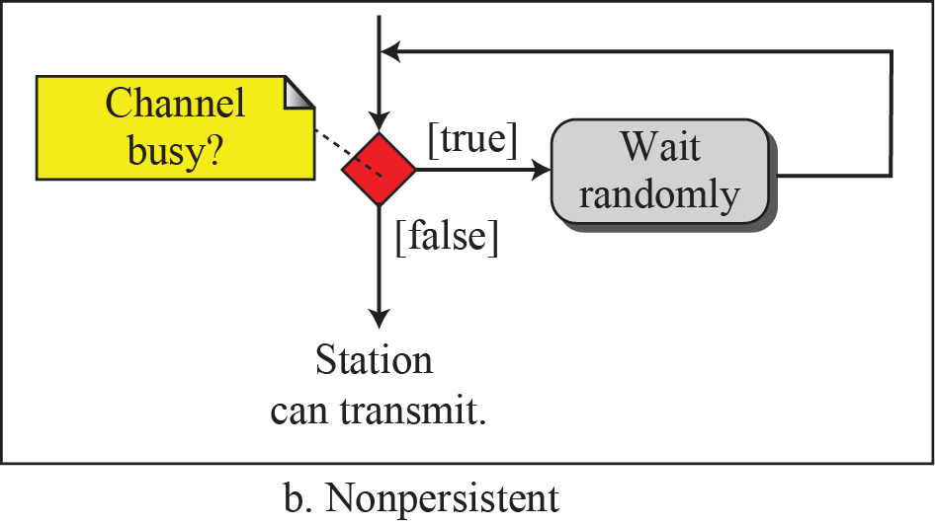
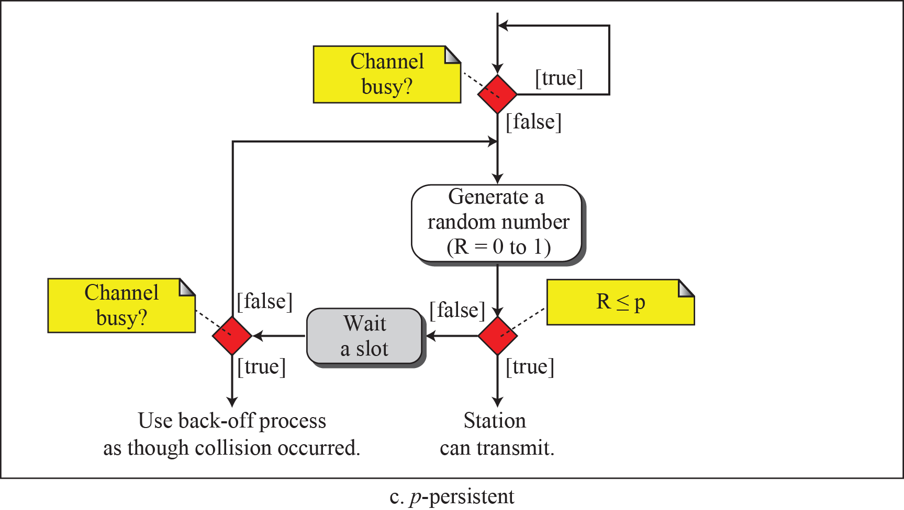
Flow diagram for three persistence methods

Slide 21
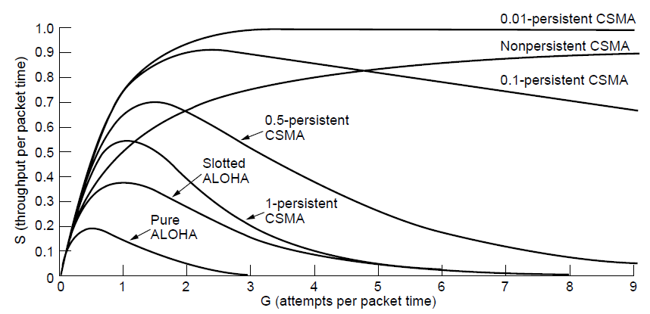
Performance of CSMA
CSMA outperforms ALOHA, and being less persistent is better under high load

Slide 22
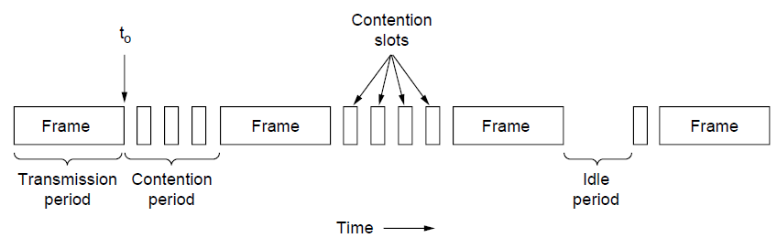
CSMA with Collision Detection
CSMA/CD improvement is to detect/abort collisions
Reduced contention times improve performance
A station monitors the medium after it sends a frame to see if the transmission was successful.
If so, the station is finished.
If there is a collision, the frame is sent again.
Collision time is much shorter than frame time

Slide 23
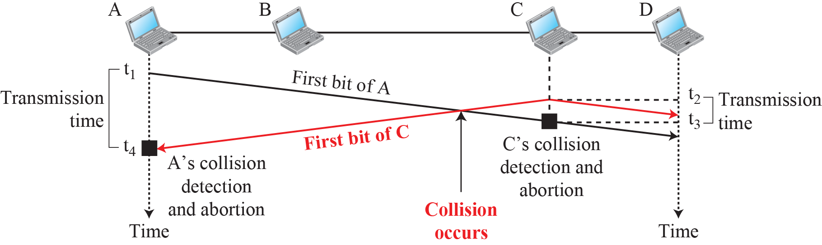
Collision of the first bit in CSMA/CD

Slide 24
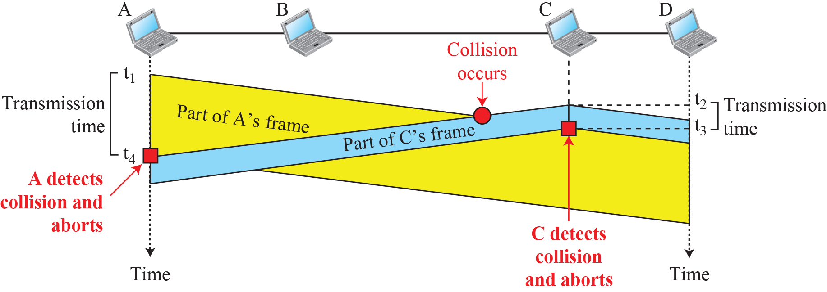
Collision and abortion in CSMA/CD

Slide 25
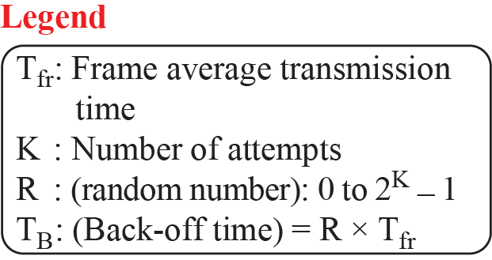
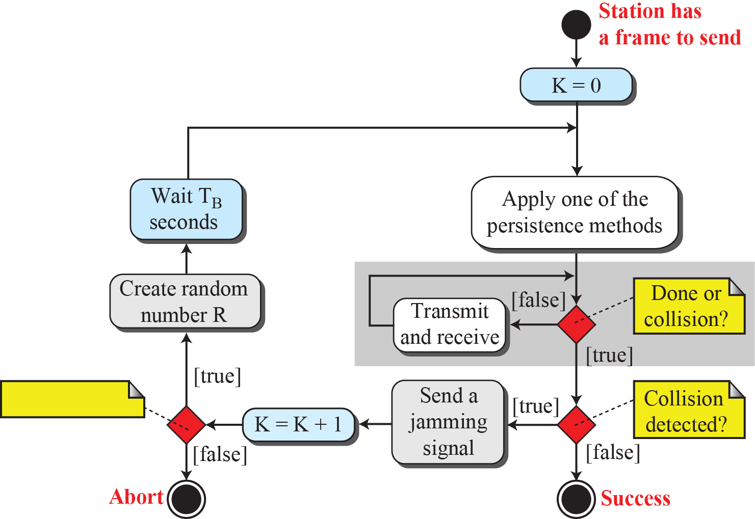
Flow diagram for CSMA/CD

Slide 26
Example
A network using CSMA/CD has a bandwidth of 10 Mbps. If the maximum propagation time (including the delays in the devices and ignoring the time needed to send a jamming signal) is 25.6 μs, what is the minimum size of the frame?
Solution
The minimum frame transmission time is 2 × T_{p} = 51.2 μs. This means, in the worst case, a station needs to transmit for a period of 51.2 μs to detect the collision.
The minimum size of the frame is 10 Mbps × 51.2 μs = 512 bits or 64 bytes. This is actually the minimum size of the frame for Standard Ethernet, as we will see later in the chapter.

Slide 27
Multiple Access Protocols
ALOHA »
CSMA (Carrier Sense Multiple Access) »
Collision-free protocols »
Limited-contention protocols »
Wireless LAN protocols »

Slide 28
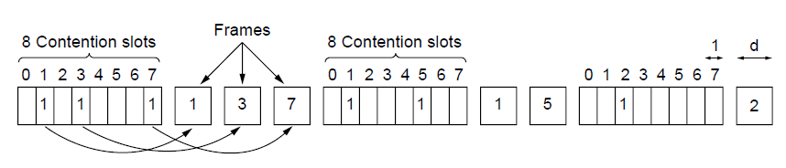
Collision-Free (1) – Bitmap
Collision-free protocols avoid collisions entirely
Senders must know when it is their turn to send
The basic bit-map protocol:
Sender set a bit in contention slot if they have data
Senders send in turn; everyone knows who has data
Notes:
reservation: a station needs to make a reservation before sending data. Time is divided into intervals. In each interval, a reservation frame precedes the data frames sent in that interval.

Slide 29
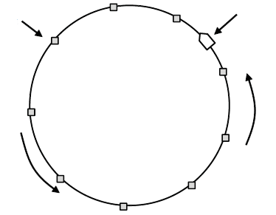
Collision-Free (2) – Token Ring
Token sent round ring defines the sending order
Station with token may send a frame before passing
Idea can be used without ring too, e.g., token bus
Token
Station
Direction of
transmission
Notes:
Token ring: the stations in a network are organized in a logical ring. For each station, there is a predecessor and a successor. The predecessor is the station which is logically before the station in the ring; the successor is the station which is after the station in the ring.

Slide 30
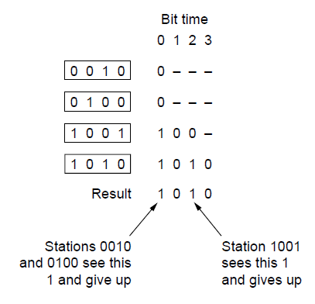
Collision-Free (3) – Countdown
Binary countdown improves on the bitmap protocol
Stations send their address in contention slot (log N bits instead of N bits)
Medium ORs bits; stations give up when they send a “0” but see a “1”
Station that sees its full address is next to send

Slide 31
Multiple Access Protocols
ALOHA »
CSMA (Carrier Sense Multiple Access) »
Collision-free protocols »
Limited-contention protocols »
Wireless LAN protocols »

Slide 32
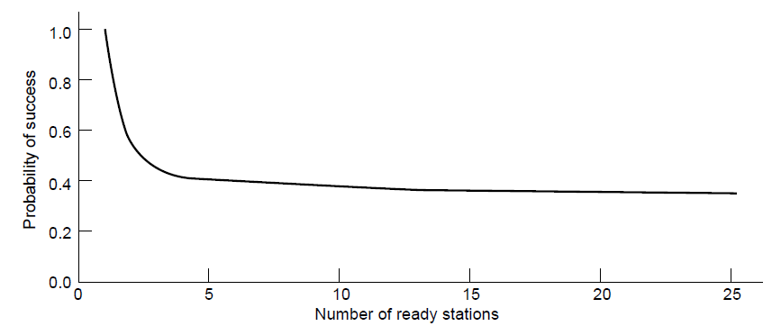
Limited-Contention Protocols (1)
Idea is to divide stations into groups within which only a very small number are likely to want to send
Avoids wastage due to idle periods and collisions
Already too many contenders for a good chance of one winner

Slide 33
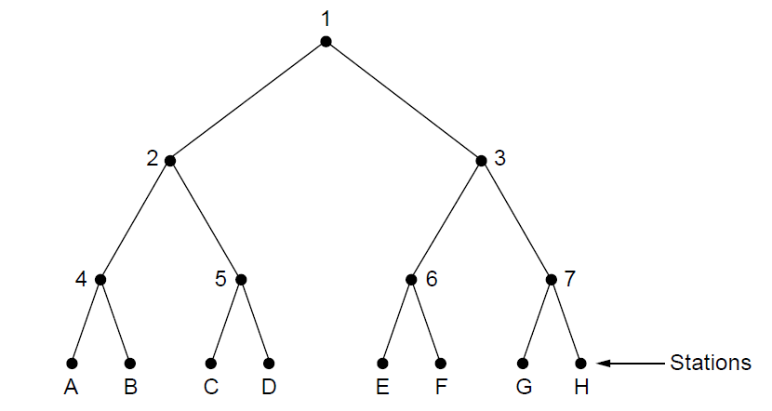
Limited Contention (2) –Adaptive Tree Walk
Tree divides stations into groups (nodes) to poll
Depth first search under nodes with poll collisions
Start search at lower levels if >1 station expected
At what level in the tree should the search begin?
Each node at level I has a fraction 2^{-i} of the stations below it.
If the number of ready stations is q and uniformly distributed, the mean number of contending stations per slot is 1. i.e., 2^{-i} q = 1
i =log₂q
Level 0
Level 1
Level 2

Slide 34
Multiple Access Protocols
ALOHA »
CSMA (Carrier Sense Multiple Access) »
Collision-free protocols »
Limited-contention protocols »
Wireless LAN protocols »

Slide 35
Wireless LAN Protocols
Wireless has complications compared to wired.
Nodes may have different coverage regions
Leads to hidden and exposed terminals
Nodes can’t detect collisions, i.e., sense while sending
Makes collisions expensive and to be avoided

Slide 36
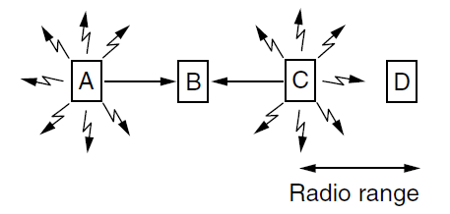
Hidden terminals
Hidden terminals are senders that cannot sense each other but nonetheless collide at intended receiver
Want to prevent; loss of efficiency
A and C are hidden terminals when sending to B

Slide 37
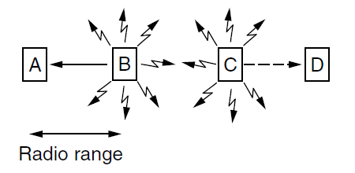
Exposed terminals
Exposed terminals are senders who can sense each other but still transmit safely (to different receivers)
Desirably concurrency; improves performance
B → A and C → D are exposed terminals

Slide 38
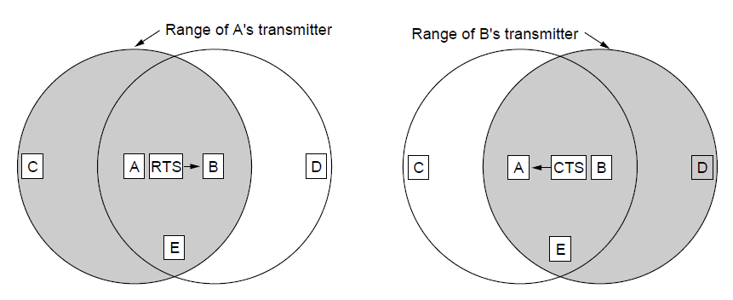
Multiple Access with Collision Avoidance
MACA protocol grants access for A to send to B:
A sends RTS to B [left]; B replies with CTS [right]
A can send with exposed but no hidden terminals
A sends RTS to B; C and E hear and defer for CTS
B replies with CTS; D and E hear and defer for data
Notes:
This protocol solves the issue of expensive collisions too, since the RTS/CTS are short packets – if there is a collision it will be brief, not as long as a data frame.

Slide 39
Medium Access Control Sublayer Chapter 4
Channel Allocation Problem
Multiple Access Protocols
Ethernet
Wireless LANs
Broadband Wireless
Bluetooth
RFID
Data Link Layer Switching

Slide 40
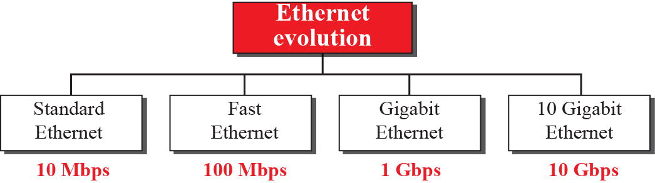
Ethernet
Classic Ethernet »
Switched/Fast Ethernet »
Gigabit/10 Gigabit Ethernet »
802.3
802.3u
802.3z
802.3ae

Slide 41
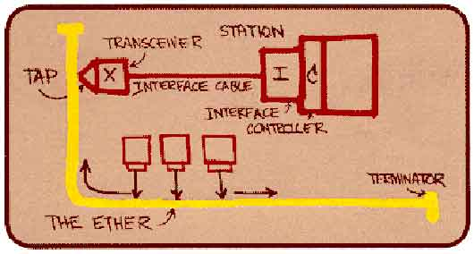
Ethernet
“Dominant” LAN technology developed in the 1970s by Robert Metcalfe and David Boggs.
First widely used LAN technology
Simpler, cheaper than token LANs and ATM
Kept up with speed race: 10, 100, 1000 Mbps 10Gbps, …
Metcalfe’s Ethernet
sketch

Slide 42
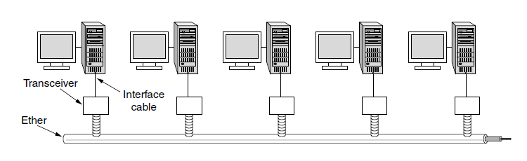
Classic Ethernet – Physical Layer
One shared coaxial cable to which all hosts attached
Up to 10 Mbps, with Manchester encoding
Hosts ran the classic Ethernet protocol for access

Slide 43
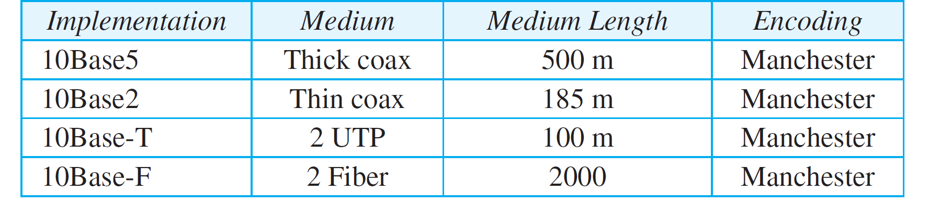
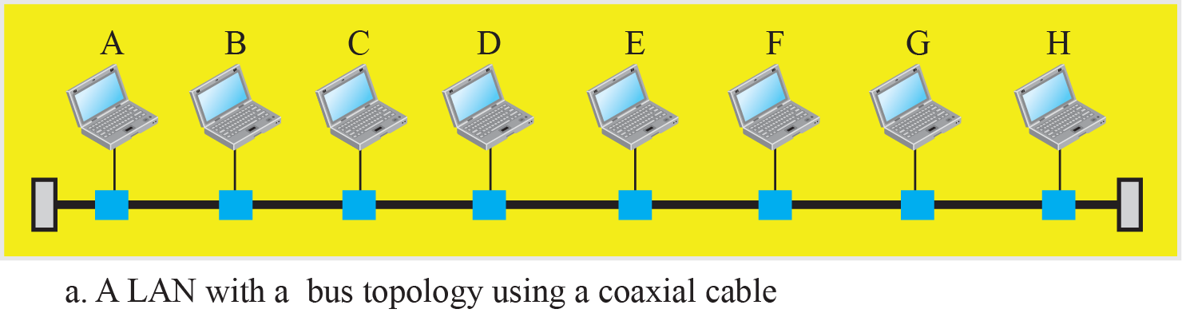
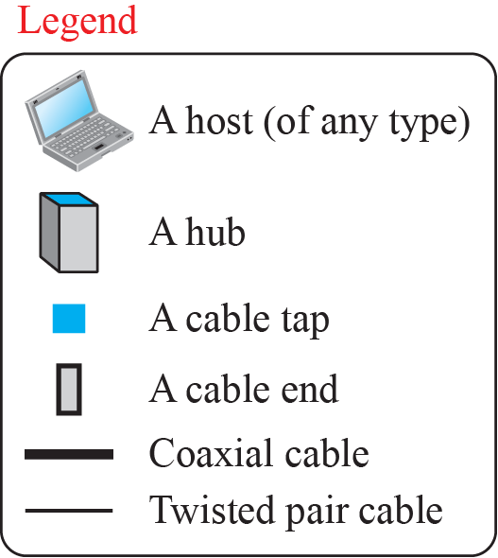
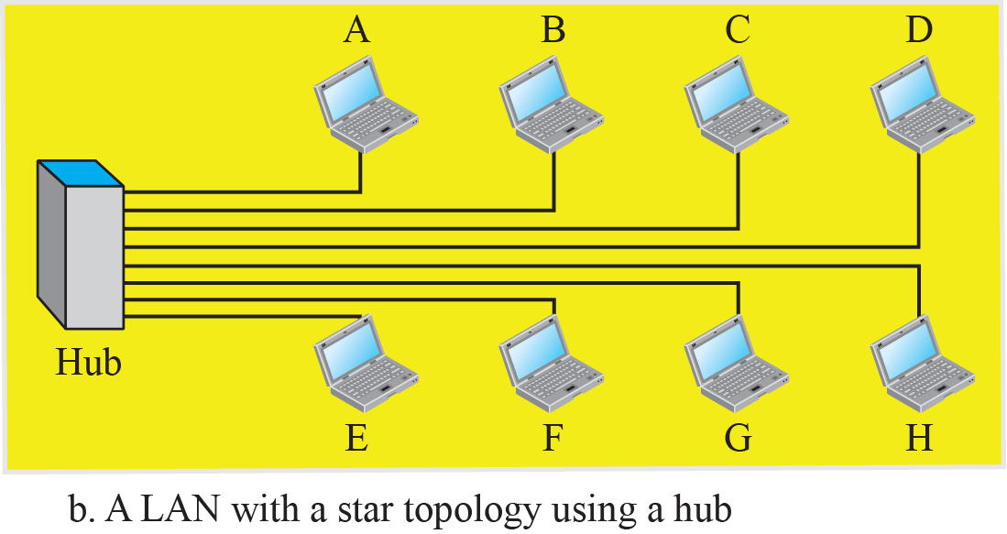
Classic Ethernet – Implementation

Slide 44
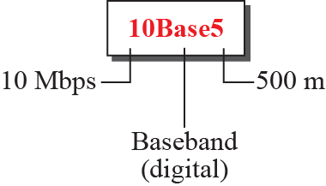
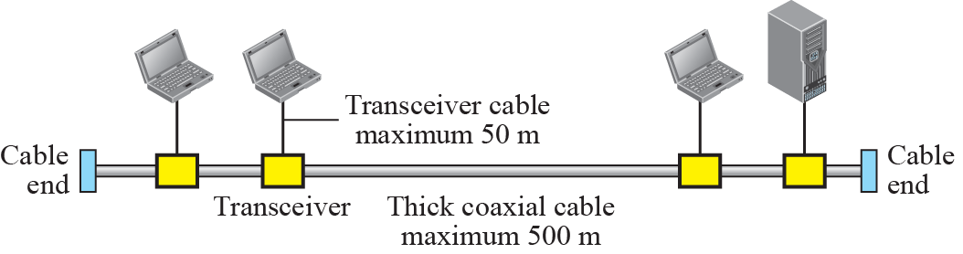
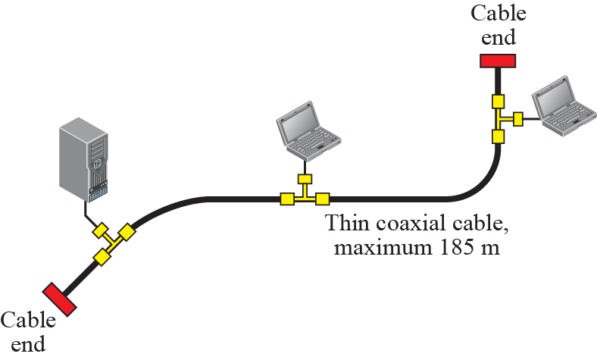
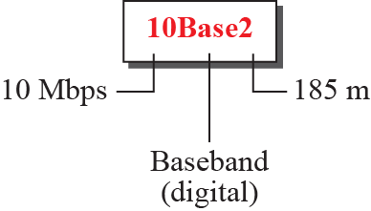
Classic Ethernet – 10Base5 and 10Base2

Slide 45
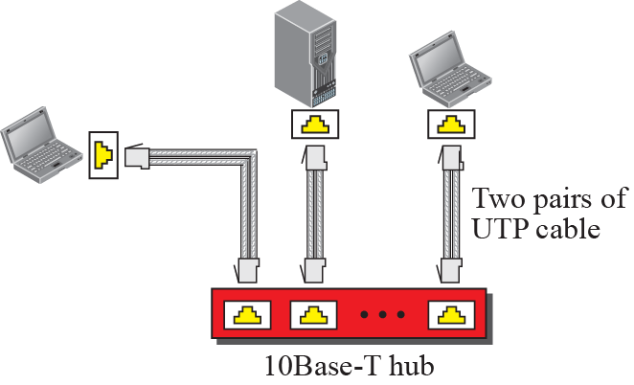
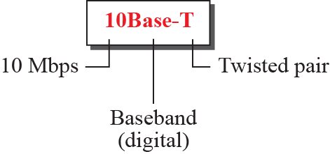
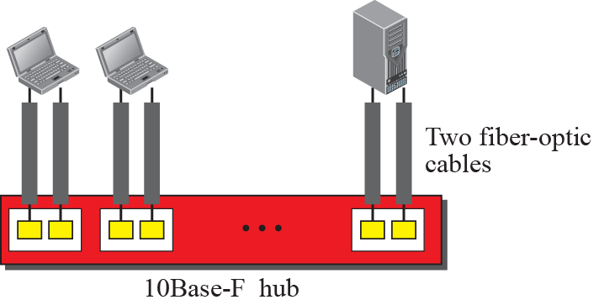
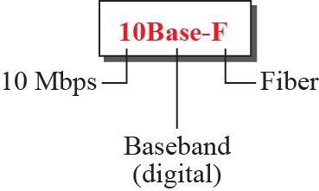
Classic Ethernet – 10BaseT and 10BaseF

Slide 46
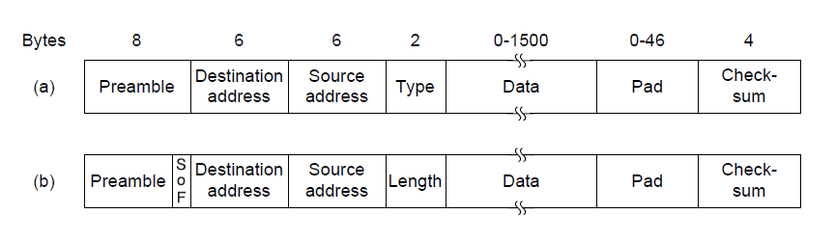
Classic Ethernet – MAC and Frame
MAC protocol is 1-persistent CSMA/CD (earlier)
Random delay (backoff) after collision is computed with BEB (Binary Exponential Backoff)
Frame format is still used with modern Ethernet.
Ethernet
(DIX)
IEEE 802.3

Slide 47
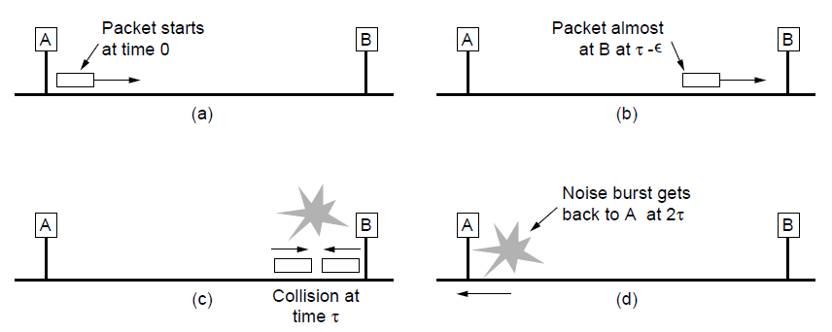
Classic Ethernet – CSMA/CD
Collisions can occur and take as long as 2τ to detect
τ is the time it takes to propagate over the Ethernet
Leads to minimum packet size for reliable detection

Slide 48
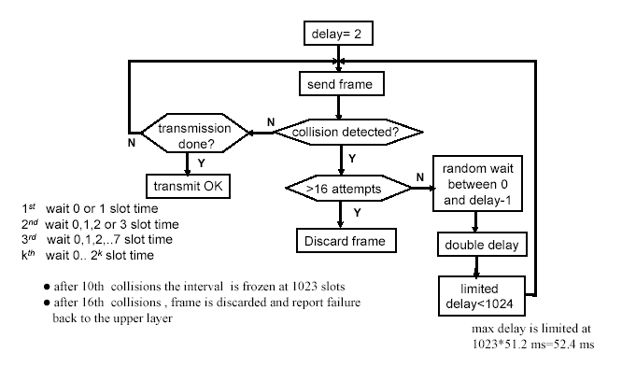
Classic Ethernet – CSMA/CD with BEB

Slide 49
Classic Ethernet – Addressing
Each station on an Ethernet network (such as a PC, workstation, or printer) has its own network interface card (NIC).
The NIC fits inside the station and provides the station with a link-layer address.
The Ethernet address is 6 bytes (48 bits), normally written in hexadecimal notation, with a colon between the bytes.
For example, the following shows an Ethernet MAC address:
4A:30:10:21:10:1A
You can use “ipconfig /all” to check the MAC addresses of your PC or laptop.

Slide 50
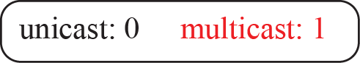
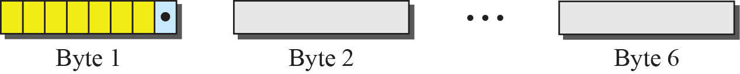
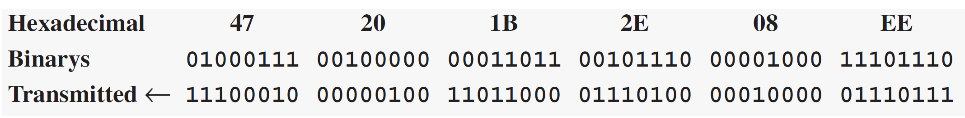
Classic Ethernet – unicast and multicast address
To find the type of the address, we need to look at the second hexadecimal digit from the left.
If it is even, the address is unicast.
If it is odd, the address is multicast.
If all digits are Fs, the address is broadcast.

Slide 51
Example
Define the type of the following destination addresses:
4A:30:10:21:10:1A
47:20:1B:2E:08:EE
FF:FF:FF:FF:FF:FF
Solution
a. This is a unicast address because A in binary is 1010 (even).
b. This is a multicast address because 7 in binary is 0111 (odd).
c. This is a broadcast address because all digits are Fs in
hexadecimal.

Slide 52
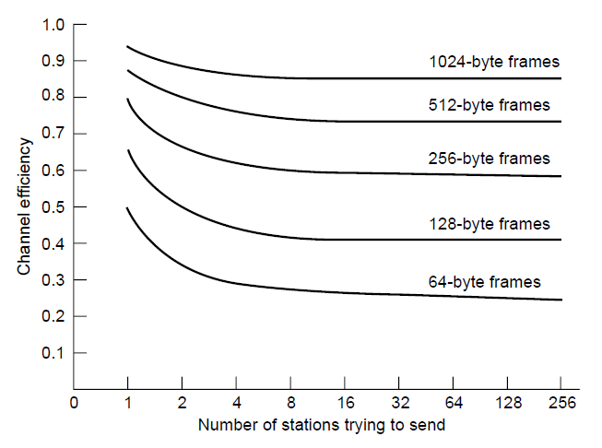
Classic Ethernet – Performance
Efficient for large frames, even with many senders
Degrades for small frames (and long LANs)
10 Mbps Ethernet,
64 byte min. frame

Slide 53
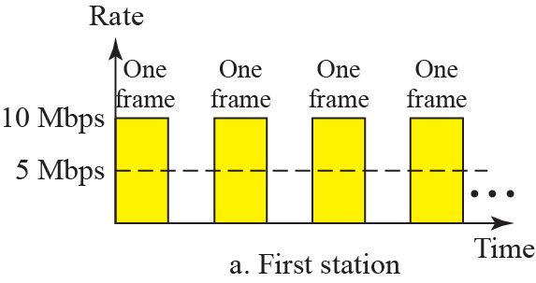

Classic Ethernet – Bandwidth sharing

Slide 54


Collision domains
A bridge is the separation of the collision domain

Slide 55


Full-duplex Switched Ethernet

Slide 56

Switched/Fast Ethernet (1)
Hubs wire all lines into a single CSMA/CD domain
Switches isolate each port to a separate domain
Much greater throughput for multiple ports
No need for CSMA/CD with full-duplex lines

Slide 57

Switched/Fast Ethernet (2)
Switches can be wired to computers, hubs and switches
Hubs concentrate traffic from computers
More on how to switch frames the in 4.8
Switch
Hub
Switch ports
Twisted pair

Slide 58

Switched/Fast Ethernet (3)
Fast Ethernet extended Ethernet from 10 to 100 Mbps
The MAC sublayer was left unchanged.
To keep the minimum size of the frame, the maximum length of the network should be 10 times shorter
Twisted pair (with Cat 5) dominated the market

Slide 59



Encoding for fast Ethernet

Slide 60

Gigabit / 10 Gigabit Ethernet
Switched Gigabit Ethernet is now the garden variety
With full-duplex lines between computers/switches

Slide 61
Gigabit / 10 Gigabit Ethernet – operation mode
The address length, the frame format, and the maximum and minimum frame length are kept the same.
To achieve a data rate of 1 Gbps, this was no longer possible to keep the MAC sublayer untouched.
Gigabit Ethernet has two distinctive approaches for medium access:
half-duplex: used with a hub. CSMA/CD required. The maximum distance is 100 times less than that in classic Ethernet (2500m→25m).
full-duplex: “normal” mode. Used in central switch. buffered. No contention, no CSMA/CD

Slide 62
Gigabit / 10 Gigabit Ethernet – network radius
Two features to the standard to increase the radius:
Carrier extension: tells the hardware to add its own padding after the normal frame(64 bytes) to extend the frame to 512 bytes.
Frame bursting: allows a sender to transmit a concatenated sequence of multiple frames in a single transmission.
These two features extend the radius of the network to 200 meters.

Slide 63


Gigabit / 10 Gigabit Ethernet – implementation
Gigabit Ethernet is commonly run over twisted pair
10 Gigabit Ethernet is being deployed where needed
40/100 Gigabit Ethernet is under development

Slide 64


Encoding in Gigabit Ethernet

Slide 65
Medium Access Control Sublayer Chapter 4
Channel Allocation Problem
Multiple Access Protocols
Ethernet
Wireless LANs
Broadband Wireless
Bluetooth
RFID
Data Link Layer Switching

Slide 66
Wireless LANs
802.11 architecture/protocol stack »
802.11 physical layer »
802.11 MAC »
802.11 frames »

Slide 67

802.11 Architecture/Protocol Stack (1)
Wireless clients associate to a wired AP (Access Point)
Called infrastructure mode; there is also ad-hoc mode with no AP, but that is rare.
To Network
Access Point
Client

Slide 68

802.11 Architecture/Protocol Stack (2)
MAC is used across different physical layers

Slide 69



Basic Service Set & Extended Service Set

Slide 70
802.11 physical layer
NICs are compatible with multiple physical layers
E.g., 802.11 a/b/g
Name | Technique | Max. Bit Rate
802.11b | Spread spectrum, 2.4 GHz | 11 Mbps
802.11g | OFDM, 2.4 GHz | 54 Mbps
802.11a | OFDM, 5 GHz | 54 Mbps
802.11n | OFDM with MIMO, 2.4/5 GHz | 600 Mbps

Slide 71

Flow Diagram for CSMA/CA

Slide 72

802.11 MAC (1)
CSMA/CA inserts backoff slots to avoid collisions
MAC uses ACKs/retransmissions for wireless errors

Slide 73

802.11 MAC (2)
Virtual channel sensing with the NAV and optional RTS/CTS (often not used) avoids hidden terminals

Slide 74

802.11 MAC (3)
Different backoff slot times add quality of service
Short intervals give preferred access, e.g., control, VoIP
MAC has other mechanisms too, e.g., power save

Slide 75

802.11 Frames
Frames vary depending on their type (Frame control)
Data frames have 3 addresses to pass via APs

Slide 76

Subfields in Frame Control field

Slide 77





Addressing Mechanism

Slide 78
Medium Access Control Sublayer Chapter 4
Channel Allocation Problem
Multiple Access Protocols
Ethernet
Wireless LANs
Broadband Wireless
Bluetooth
RFID
Data Link Layer Switching

Slide 79
Broadband Wireless
802.16 Architecture / Protocol Stack »
802.16 Physical Layer »
802.16 MAC »
802.16 Frames »

Slide 80

802.16 Architecture/Protocol Stack (1)
Wireless clients connect to a wired basestation (like 3G)

Slide 81

802.16 Architecture/Protocol Stack (2)
MAC is connection-oriented; IP is connectionless
Convergence sublayer maps between the two

Slide 82

802.16 Physical Layer
Based on OFDM; base station gives mobiles bursts (subcarrier/time frame slots) for uplink and downlink

Slide 83
802.16 MAC
Connection-oriented with base station in control
Clients request the bandwidth they need
Different kinds of service can be requested:
Constant bit rate, e.g., uncompressed voice
Real-time variable bit rate, e.g., video, Web
Non-real-time variable bit rate, e.g., file download
Best-effort for everything else

Slide 84

802.16 Frames
Frames vary depending on their type
Connection ID instead of source/dest addresses
(a)
(b)
(a) A generic frame. (b) A bandwidth request frame

Slide 85
Bluetooth
Bluetooth Architecture »
Bluetooth Applications / Protocol »
Bluetooth Radio / Link Layers »
Bluetooth Frames »

Slide 86

Bluetooth Architecture
Piconet master is connected to slave wireless devices
Slaves may be asleep (parked) to save power
Two piconets can be bridged into a scatternet

Slide 87

Bluetooth Applications / Protocol Stack
Profiles give the set of protocols for a given application
25 profiles, including headset, intercom, streaming audio, remote control, personal area network, …

Slide 88
Bluetooth Radio / Link Layers
Radio layer
Uses adaptive frequency hopping in 2.4 GHz band
Link layer
TDM with timeslots for master and slaves
Synchronous CO for periodic slots in each direction
Asynchronous CL for packet-switched data
Links undergo pairing (user confirms passkey/PIN) to authorize them before use

Slide 89

Bluetooth Frames
Time is slotted; enhanced data rates send faster but for the same time; addresses are only 3 bits for 8 devices
(a)
(b)
(a)
(b)

Slide 90
RFID
Gen 2 Architecture »
Gen 2 Physical Layer »
Gen 2 Tag Identification Layer »
Gen 2 Frames »

Slide 91

Gen 2 Architecture
Reader signal powers tags; tags reply with backscatter

Slide 92

Gen 2 Physical Layer
Reader uses duration of on period to send 0/1
Tag backscatters reader signal in pulses to send 0/1

Slide 93

Gen 2 Tag Identification Layer
Reader sends query and sets slot structure
Tags reply (RN16) in a random slot; may collide
Reader asks one tag for its identifier (ACK)
Process continues until no tags are left

Slide 94

Gen 2 Frames
Reader frames vary depending on type (Command)
Query shown below, has parameters and error detection
Tag responses are simply data
Reader sets timing and knows the expected format
Query message

Slide 95
Medium Access Control Sublayer Chapter 4
Channel Allocation Problem
Multiple Access Protocols
Ethernet
Wireless LANs
Broadband Wireless
Bluetooth
RFID
Data Link Layer Switching

Slide 96
Data Link Layer Switching
Uses of Bridges »
Learning Bridges »
Spanning Tree »
Repeaters, hubs, bridges, .., routers, gateways »
Virtual LANs »

Slide 97

Uses of Bridges
Common setup is a building with centralized wiring
Bridges (switches) are placed in or near wiring closets

Slide 98

Learning Bridges (1)
A bridge operates as a switched LAN (not a hub)
Computers, bridges, and hubs connect to its ports

Slide 99
Learning Bridges (2)
Backward learning algorithm picks the output port:
Associates source address on frame with input port
Frame with destination address sent to learned port
Unlearned destinations are sent to all other ports
Needs no configuration
Forget unused addresses to allow changes
Bandwidth efficient for two-way traffic

Slide 100

Learning Bridges (3)
Bridges extend the Link layer:
Use but don’t remove Ethernet header/addresses
Do not inspect Network header

Slide 101

Spanning Tree (1) – Problem
Bridge topologies with loops and only backward learning will cause frames to circulate for ever
Need spanning tree support to solve problem

Slide 102
Spanning Tree (2) – Algorithm
Subset of forwarding ports for data is use to avoid loops
Selected with the spanning tree distributed algorithm by Perlman
I think that I shall never see
A graph more lovely than a tree.
A tree whose crucial property
Is loop-free connectivity.
A tree which must be sure to span.
So packets can reach every LAN.
First the Root must be selected
By ID it is elected.
Least cost paths from Root are traced
In the tree these paths are placed.
A mesh is made by folks like me
Then bridges find a spanning tree.
– Radia Perlman, 1985.

Slide 103

Spanning Tree (3) – Example
After the algorithm runs:
B1 is the root, two dashed links are turned off
B4 uses link to B2 (lower than B3 also at distance 1)
B5 uses B3 (distance 1 versus B4 at distance 2)

Slide 104

Repeaters, Hubs, Bridges, Switches, Routers, & Gateways
Devices are named according to the layer they process
A bridge or LAN switch operates in the Link layer

Slide 105

Virtual LANs (1)
VLANs (Virtual LANs) splits one physical LAN into multiple logical LANs to ease management tasks
Ports are “colored” according to their VLAN

Slide 106

Virtual LANs (2) – IEEE 802.1Q
Bridges need to be aware of VLANs to support them
In 802.1Q, frames are tagged with their “color”
Legacy switches with no tags are supported

Slide 107

Virtual LANs (3) – IEEE 802.1Q
802.1Q frames carry a color tag (VLAN identifier)
Length/Type value is 0x8100 for VLAN protocol

Slide 108
End
Chapter 4

